Slide 1
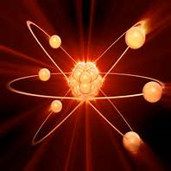
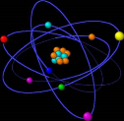
Atoms
LO: To learn about the structure of atoms (recap from year 9)
Better than expected progress:
Will have modelled the nuclear symbol of an atom (atomic number and mass number)
Will have explained what the overall charge of an atom is and why.
Expected progress: Will have modelled and labelled the structure of an atom and stated the properties of the subatomic particles in the atom.
Outstanding progress:
Will have researched the history of an atom.
Will have completed the questions on SENECA
CONNECT: WATCH THIS CLIP WHICH INTRODUCES ATOMS
https://www.youtube.com/watch?v=R1RMV5qhwyE

Slide 2
Week 1: Task 1
Use the following slides to produce your own key fact resource sheet which contains the following information:
How big an atom actually is and which part of the atom is the smallest.
A labelled diagram of an atom showing where you would find the protons, neutrons and electrons.
A fact sheet comparing protons, neutrons and electrons (include information about their charge and mass.
A labelled diagram to show how we use the symbol of an atom in the periodic table to work out the number of protons, neutrons and electrons in that atom.

Slide 3
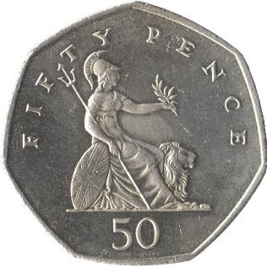
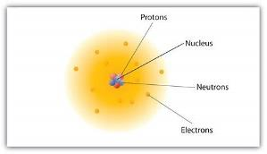
ATOMS…KEY FACTS!
A 50 pence coin contains a whole lot of atoms…that makes atoms tiny!!
77 400000000000000000000 atoms!!!!!!
The radius of an atom is 0.1 nm which is equivalent to 1x10⁻¹⁰m OR 0.0000000001 m (TINY!)
A bacterium has a radius of 1x10⁻⁶m so an atom is even smaller!!
The nucleus (centre) has the largest mass but is only 1/10 000 of the whole atom! TINY!!!

Slide 4
The structure of the atom
Electron shell (energy levels) – contains electrons
1st shell (energy level) has up to 2 electrons
All other shells (energy levels) have up to 8 electrons.
ELECTRON – negative charge
PROTON – positive charge
NEUTRON – neutral charge
Nucleus – contains protons and neutrons

Slide 5
Key facts about atoms
Particle | Relative Mass | Relative Charge
Proton | 1 | +1 (Positive)
Neutron | 1 | 0 (Neutral)
Electron | 0.0005 (very small) | - 1(Negative)
How do we find out the number of protons, neutrons and electrons in different elements? (Better than expected)
Nuclear symbols
(Atomic) MASS NUMBER = number of protons + number of neutrons in the nucleus
4
He
SYMBOL for the element Helium!
2
ATOMIC (proton) NUMBER = number of protons
How do we find out the number of electrons?

Slide 6
Some key words and definitions
Atomic mass – The number of protons and neutrons which are found in the nucleus. (they do not include electrons as they have minimal mass)
Atomic number – the number of protons in the nucleus (as these are positive, and electrons are negative, an atom tends to have the same number of protons as electrons. That way the overall atom has ‘no charge’.
Relative atomic mass – Each type of atom has a different mass, but these amounts are too small to measure. Instead they invented a scale where the lightest element (hydrogen) has a mass of 1. From that, we can work out the next lightest, which is helium, etc… This is R.A.M.!

Slide 7
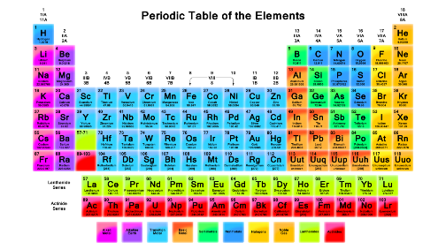
Calculate the numbers!
Week 1: Task 2
TASK
Use the periodic table; for the elements below, find out the number of protons, neutrons and electrons. (FIND THE PERIODIC TABLE ON THE INTERNET TO SEE THE ATOMIC NUMBER AND ATOMIC MASS NUMBER)
Magnesium
Chlorine
Oxygen
Lead
Sodium
Fluorine
Carbon
Neon
Calcium

Slide 8
What is the overall charge of an atom for any element?
WHY? (Apply your knowledge about nuclear symbols to explain)
Week 1: Task 3
This site may help you answer the questions.
https://www.bbc.co.uk/bitesize/guides/z6426yc/revision/1
Which has a greater mass; the nucleus of an atom or the electron shells (energy levels)?
WHY? (Apply your knowledge about subatomic particles and atomic structure to explain)

Slide 9
Atoms
LO: To learn about the structure of atoms (recap from year 9)
Better than expected progress:
Will have modelled the nuclear symbol of an atom (atomic number and mass number)
Will have explained what the overall charge of an atom is and why.
Expected progress: Will have modelled and labelled the structure of an atom and stated the properties of the subatomic particles in the atom.
Outstanding progress:
Will have researched the ‘history of an atom’
Will have completed the questions on SENECA
CONNECT: WATCH THIS CLIP WHICH INTRODUCES ATOMS
https://www.youtube.com/watch?v=R1RMV5qhwyE

Slide 10
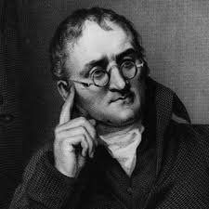
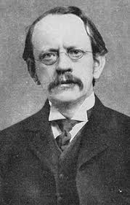
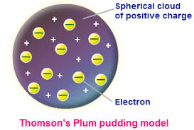
WEEK 1: TASK 4
TASK 4: Many scientists contributed towards our present model of the atom (called the nuclear model)
Use the next few slides to outline what each Scientist discovered or proposed.
John Dalton (19th Century) – described atoms as solid spheres and said that elements were made from different types of spheres
JJ Thomson (1897) – he proposed the ‘plum pudding model’
His model showed negative charged electrons surrounded by positive charges.
He did experiments to show that atoms weren’t solid.
He discovered smaller negative particles inside the atom called electrons.

Slide 11
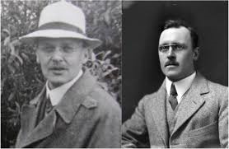
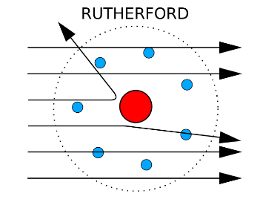
LO: To compare how models of atoms have changed over time.
Ernest Rutherford and Ernest Marsden (1909) – they carried out the ‘alpha scattering experiment’
They fired positive alpha particles at a thin sheet of gold.
Some of the particles went straight through the sheet but some were deflected at angles or deflected backwards.
This showed that the ‘plum pudding’ model was wrong! (this proposed that they would pass straight through)
The centre of the atom must have a positively charged nucleus which caused the positive alpha particles to repel and deflect backwards.
The rest of the atom is empty space which causes the alpha particles to pass straight through.

Slide 12
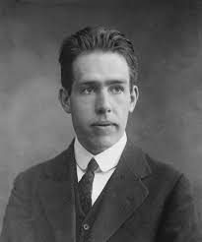
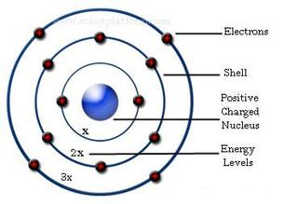
LO: To compare how models of atoms have changed over time.
Niels Bohr proposed the Bohr’s nuclear model -
He proposed that electrons orbit the nucleus in electron shells or energy shells at fixed distances from the nucleus.
The electrons are attracted to the positive nucleus but they are in shells so that the atom wouldn’t collapse.

Slide 13
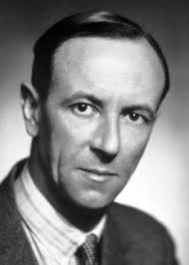
WEEK 1: Task LO: To compare how models of atoms have changed over time.
Rutherford carried out further tests and identified protons in the nucleus of atoms. (He didn’t propose that electrons were in electron shells though!)
James Chadwick (20 years later)- he carried out further experiments and identified neutral substances called neutrons in the nucleus.
PLENARY: As a recap…draw a model of what the modern structure of an atom looks like (The nuclear model)
Rutherford, Bohr and Chadwick all proposed ‘nuclear models’ but whose model is closer to our modern day model?

