Slide 1
LO: To compare different types of nuclear reactions
WEEK 3
Expected Progress
Will have drawn diagrams to show nuclear fission and nuclear fusion reactions.
Will have compared where each reaction takes place.
(PASS)
Better than Expected Progress
Will have explained why fission reactions are dangerous and how they are controlled on power stations.
2) Will have explained why fusion reactions are less difficult to control.
(MERIT)
CONNECT:
Watch this clip below to learn about the processes of nuclear fission and fusion
https://www.bbc.co.uk/bitesize/guides/zx86y4j/revision/1

Slide 2
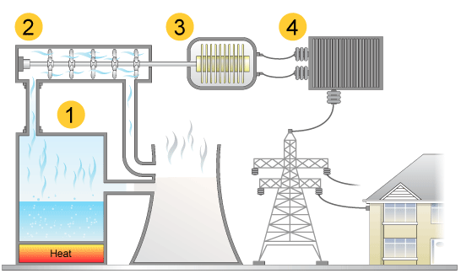
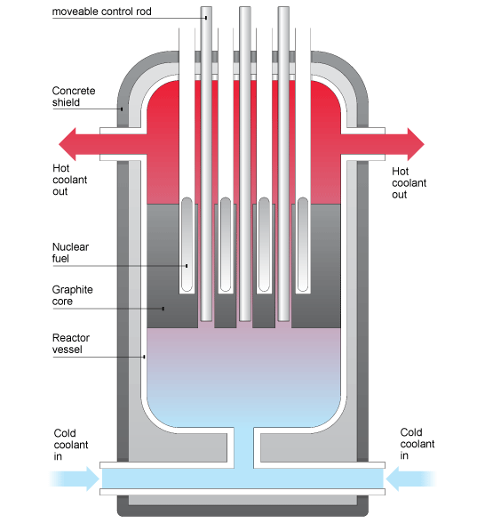
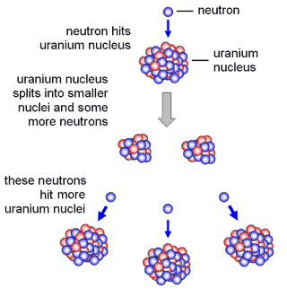
TASK 1: Put the title ‘nuclear fission’ and use the next 2 slides to explain….
What nuclear fission is
Where the process takes place
What happens in the process (Use a diagram)

Slide 3
Nuclear Fission
Nuclear fission is the process of splitting the nucleus of an atom.
It happens inside nuclear reactors in nuclear power stations.
What happens inside a nuclear reactor?
A neutron hits either an uranium-235 or plutonium-239 nucleus.
2) The nucleus splits into two smaller nuclei, which are radioactive
3) Two or three more neutrons and energy are released.
4) The additional neutrons released hit other uranium or plutonium nuclei and cause them to split.
5) Even more neutrons are then released, which in turn can split more nuclei. This is called a chain reaction.

Slide 4
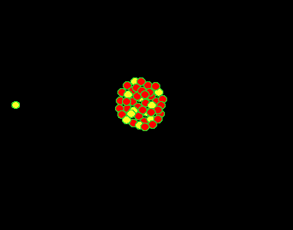
Nuclear Fission

Slide 5
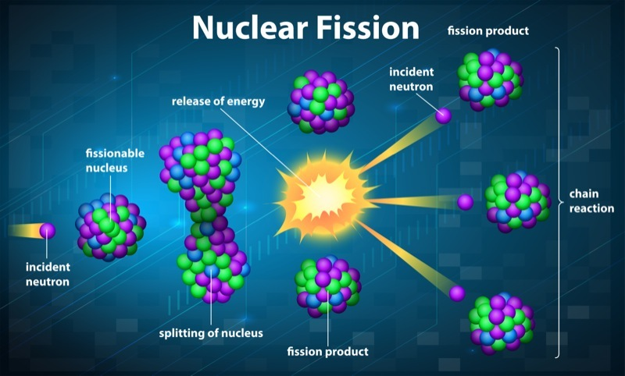
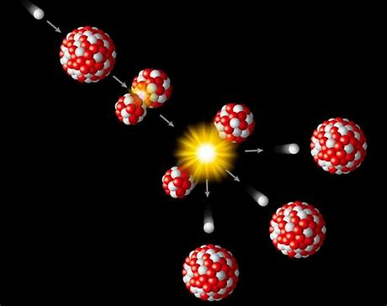
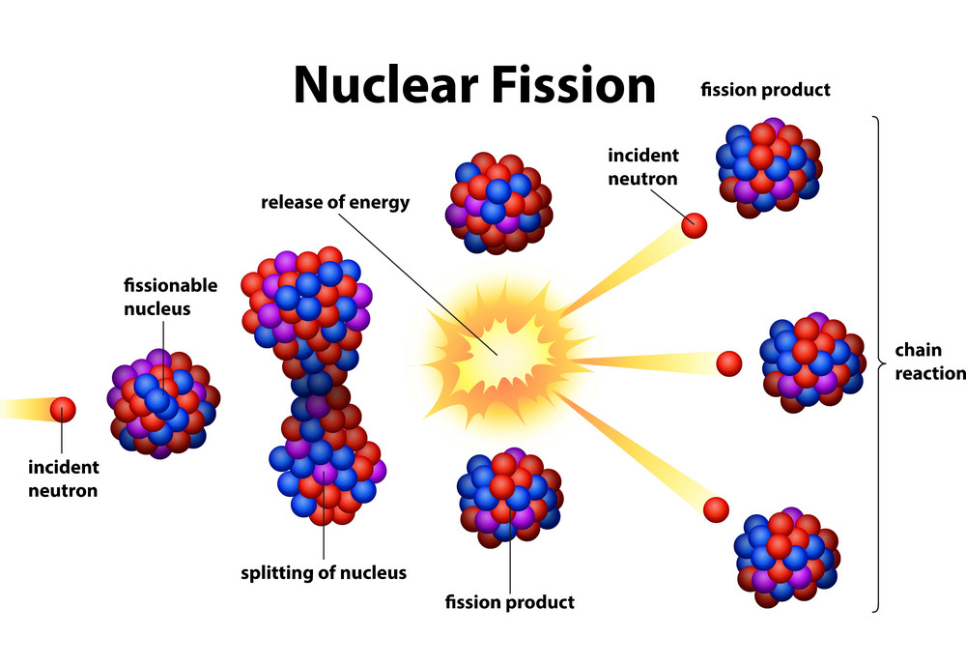
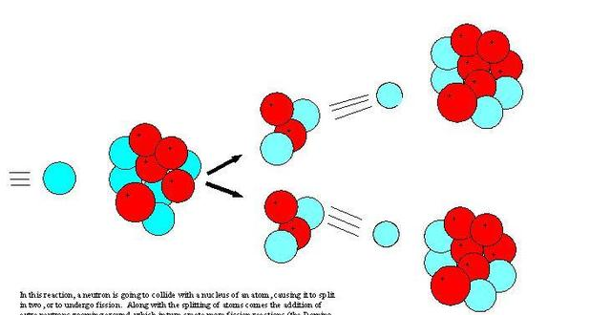
Examples of diagrams you can use

Slide 6
Nuclear fusion
Nuclear fusion involves two atomic nuclei joining to make a large nucleus.
Huge amounts of Energy is released.
Nuclear fusion happens in the Sun and other stars.
What happens in nuclear fusion?
The reaction involves hydrogen nuclei joining to form helium nuclei. Here is an example one nuclear fusion reaction that takes place:
Hydrogen-1 nuclei fuse with
hydrogen-2 nuclei.
Helium-3 nuclei is formed.
TASK 2: Put the title ‘nuclear fusion’ and use the next 2 slides to explain….
What nuclear fission is
Where the process takes place
What happens in the process

Slide 7
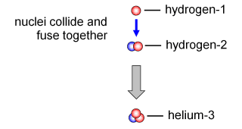
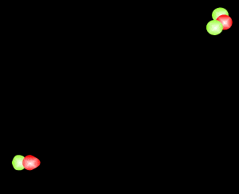
Nuclear fusion

Slide 8
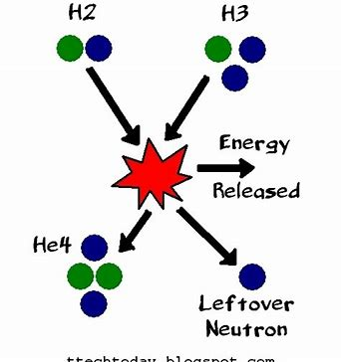
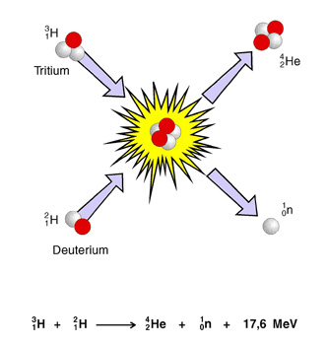
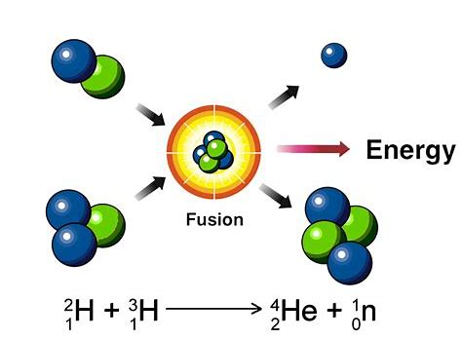
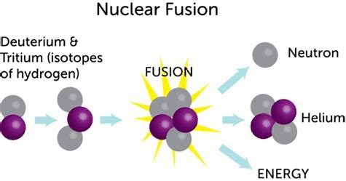
Examples of diagrams you can use

Slide 9
Task 3: Use the information below to explain why nuclear fission reactions are dangerous and then compare the function of each part of the reactor.
Nuclear reactions are dangerous because they are difficult to control. This is because a chain reaction is set up with neutrons colliding into more uranium nuclei and it can quickly get out of control and cause an explosion.
Functions of each part of a nuclear reactor:
Control rods - these made from boron and absorb some of the neutrons so that there are less to collide with the uranium nuclei which slows down the reaction.
Water is used as a coolant which slows down the reaction by removing the kinetic energy from the neutrons and fuel rods.
The reactor has thick steel walls to prevent explosions as they can withstand high heat and high pressure.
Fuel rods – these provide the uranium or plutonium so nuclear reactions can occur.

Slide 10
TASK 4: Explain How why nuclear fusion reactions are more controllable ?
Fusion reactions need an extremely high temperature and a large electrical current in order for the nuclei of atoms to fuse together.
A magnetic field is also needed to stop the nuclei touching the sides of the reactor and stopping the reaction.
Because they need such a high temperature and a large electrical current they are more controllable than fission reactions because the reaction can easily be stopped by reducing the temperature, taking away the current or taking away the magnetic field.

