Slide 1
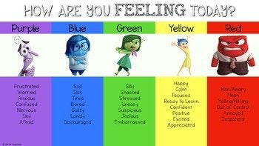
Managing our emotions…

Slide 2
Emotions are also called feelings. They are part of human nature and give us information about what we are going through.

Slide 3
Understanding our emotions and finding positive ways to manage them is really important.

Slide 4
It’s important to remember that:
Emotions come and go
Emotions can be mild, intense or anywhere in between
There are no good or bad emotions but there are positive and negative ways to express them

Slide 5
https://www.youtube.com/watch?v=dOkyKyVFnSs

Slide 6
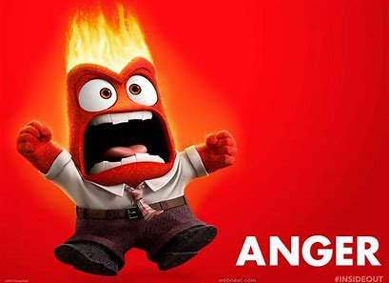
What happens when you’re angry?
How can we manage it?
Who can we talk to if we feel angry?

Slide 7
There are some great strategies you can use to help you if you feel angry…
Take a few deep breaths
Count to 10
Use the calm cave
Walk away from the situation
Go to a private or quiet place to calm down
Talk to a trusted friend or adult

Slide 8
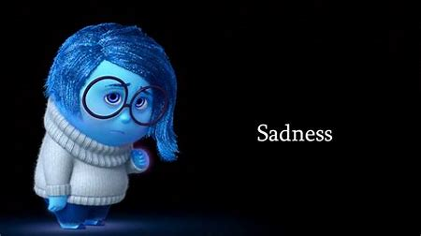
Who can you talk to if you feel sad?

Slide 9
If you’re feeling sad it can help to:
Breathe slowly
Do a physical activity
Share your thoughts and feelings with friend or trusted adult
Write down your thoughts and feeling in a journal or diary

Slide 10
What happens when you feel anxious or stressed?
How can we manage it?
Who can we talk to if we feel anxious or stressed?

Slide 11
There are lots of ways to manage fear, stress and anxiety. These can include:
Practicing relaxation techniques such as mindfulness, yoga or deep breathing
Starting a ‘worry’ box or journal where you can write down how you are feeling
Talking to a trusted friend or adult

Slide 12
Remember
Sometimes it’s hard to manage your emotions but it’s really important that you talk about them. Everyone at Meadow park is here to help you and you can talk to us about your feelingsand emotions at any time.

Slide 13
Who else can help?
Call 116 123 or email jo@samaritans.org or write a letter or visit a local branch.

Slide 14
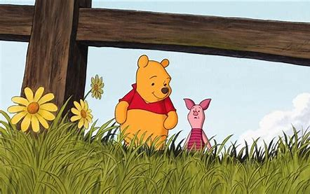
“Piglet?” Winnie the Pooh said.
“Yes?”
“Do you ever have days when everything feels…Not ok at all? And sometimes you don’t even know why you feel that way, you just know that you do?” Piglet nodded his head…
“Oh yes, I definitely have those days” he said.
“Really?” Winnie the Pooh said “I would never have thought that. You always seem so happy, you never seem angry or upset”
“Ah” said Piglet. “Well here’s the thing. There are 2 things you need to know…. The first thing is that everyone feels angry, upset, anxious and fed up, some people are just better at hiding it than others. The second is that everyone has days when they feel not ok at all. All you need to do on those days is to come and fine me and tell me. Don’t ever feel like you have to hide it. Always come and tell me, because I will always be there”.

