Slide 1

Managing your emotions

Slide 2
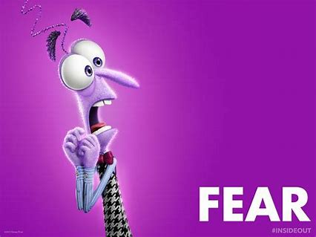
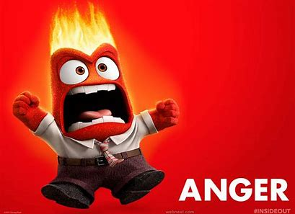
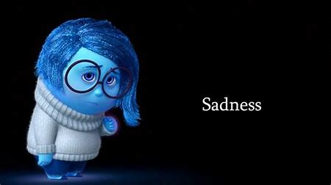
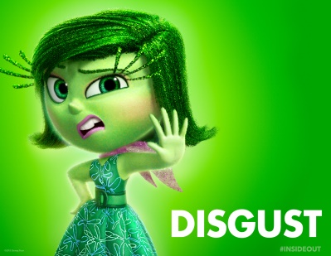
Emotions
Emotions are part of human nature. They give us information about what we’re experiencing and help us to know how to react.

Slide 3
Different types of Emotions
There are many different types of emotions including:
Fear
Anxiety
Anger
Sadness
Depression
Happiness
Disgust

Slide 4
Fear
Fear is one of the most basic human emotions. It’s programmed into our nervous system and equips us with the survival instincts necessary to respond when we sense danger or feel unsafe.
Feeling afraid is natural and it can be a good thing because it helps to protect us.

Slide 5
Like all emotions, fear can be mild or it can be very intense. Fear can make you feel:
Overwhelmed or out of control
Anxious
Like your heart is beating too fast
Unable to concentrate
Sweaty
Nauseous (sick)
Upset or tearful
Tired
Light headed

Slide 6
You can feel fearful for lots of different reasons:
Anxiety
Phobias
Worrying that you wont fit in
Stress
Fear of new things/the unknown
Fear of failure
While it’s normal to have some fear or anxiety, if you spend an excessive amount of time worrying or fear is having a negative impact on you, it may be time to get some support.

Slide 7
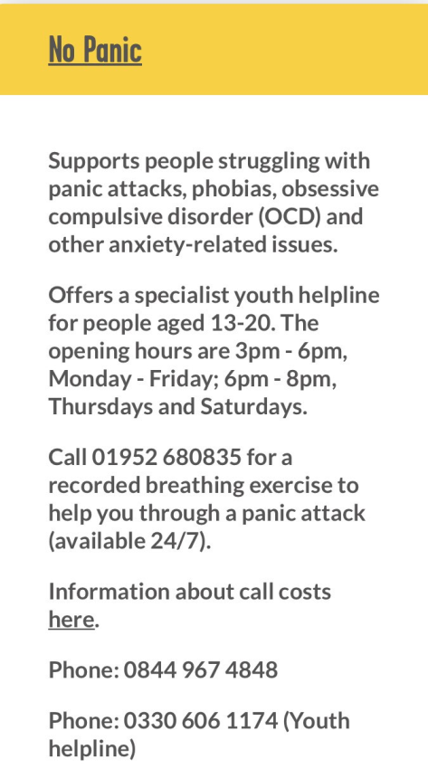
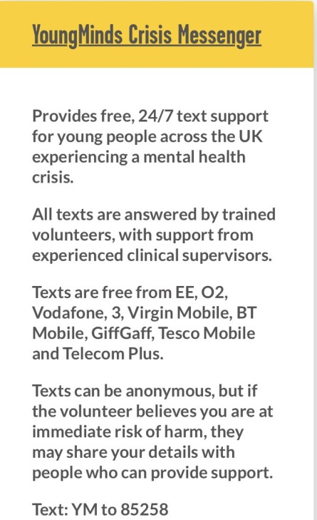

Who can help?
Although it’s not always easy, talking about fear or anxiety is really important. There are lots of people who can help…
Staff at Meadow Park
Friends
Family
Your GP
Charities

Slide 8
Anger
Everyone gets angry and it’s ok to feel anger but it must be released in the right way. It can be a difficult emotion to deal with and sometimes it can be hard to identify exactly what you feel angry about, however being constantly angry or engaging in dangerous or destructive behaviour because you feel angry isn’t safe or good for your wellbeing.

Slide 9
When you feel angry you may:
Clench your fists
Want to pace up and down
Feel like you’re about to explode
Want to lash out at things
Stop talking
Become withdrawn
Feel hot
Cry

Slide 10
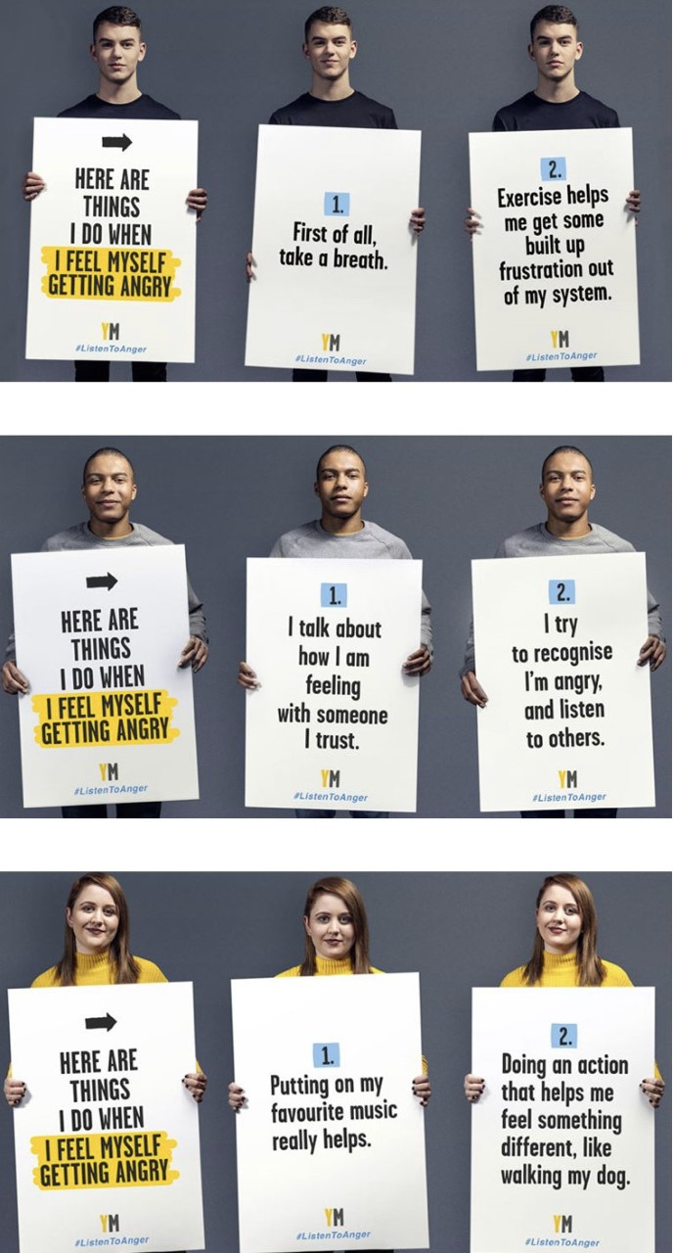
It may help to:
Go for a walk
Listen to music
Take 5 deep breaths
Go somewhere quiet
Do some exercise
Talk to someone about
how you feel

Slide 11
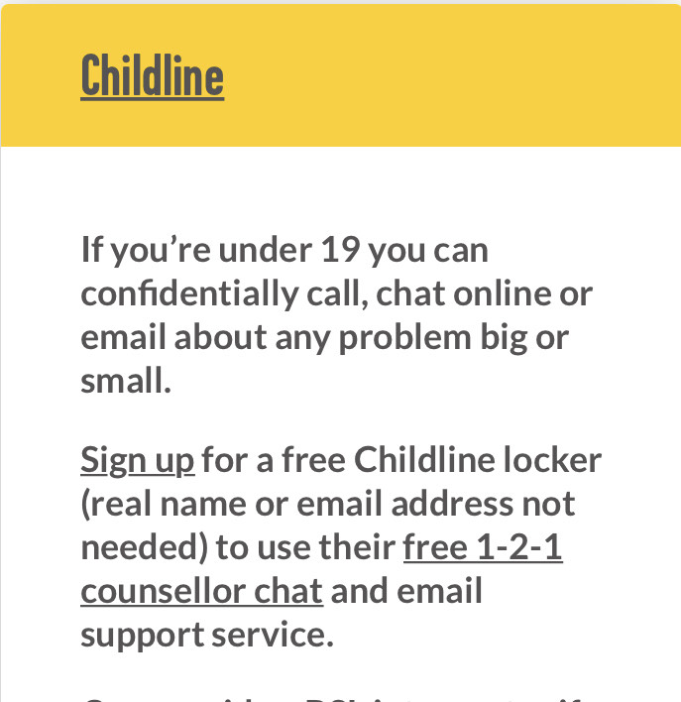


There are also charities that can help such as:
CAMHS
Young Minds
NSPCC
Childline

Slide 12
Sadness and depression
Feeling sad can be a natural and appropriate response to what is going on in life. Mostly, with the passing of time, life changes or the support of those around us these feelings go away. However if sadness and low feelings don’t go away then it may be depression. Depression can be mild or quite overwhelming, stopping people from doing or enjoying normal, every day things.

Slide 13



It’s really important not to ignore feelings of sadness and depression. Talking is key and there are lots of people who want to listen…
Your family
Your friends
Meadow Park staff
Charities

Slide 14
At some point, everyone will feel the emotions we’ve discussed in today’s assembly. But, if you’re feelings or emotions become too much, please talk to:
Your keyworkers
The mentors & therapists
SLT
A friend
A trusted adult
Any of the charities mentioned
We will also be putting up information about all of the charities in your form rooms for you to access.

Slide 15
Remember we are always here for you!
“Piglet?” Winnie the Pooh said.
“Yes?”
“Do you ever have days when everything feels…Not ok at all? And sometimes you don’t even know why you feel that way, you just know that you do?” Piglet nodded his head…
“Oh yes, I definitely have those days” he said.
“Really?” Winnie the Pooh said “I would never have thought that. You always seem so happy, you never seem angry or upset”
“Ah” said Piglet. “Well here’s the thing. There are 2 things you need to know…. The first thing is that everyone feels angry, upset, anxious and fed up, some people are just better at hiding it than others. The second is that everyone has days when they feel not ok at all. All you need to do on those days is to come and fine me and tell me. Don’t ever feel like you have to hide it. Always come and tell me, because I will always be there”.

Slide 16

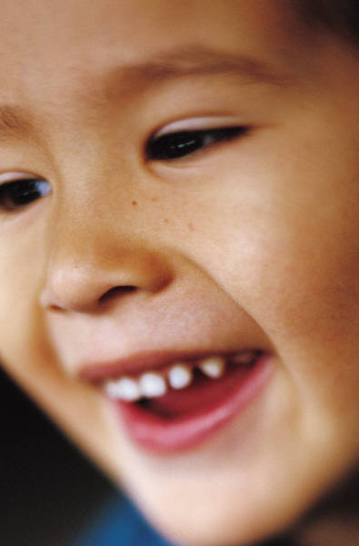
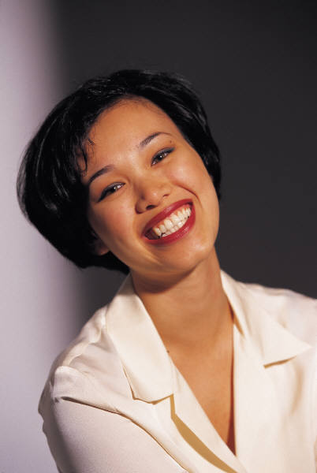
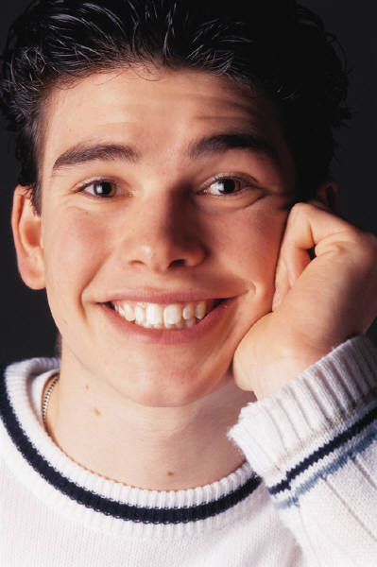
Happiness
Happiness is the only emotion which does not require much energy or put a strain on your facial muscles.

